Slide 1
Strategy and Management Control system

Slide 2
Tasks Involved in Strategic Management & MCS
Defining business and stating a mission
Setting measurable objectives
Crafting a strategy to achieve objectives
Implementing a strategy
Evaluating performance of the strategy, reviewing new developments and taking corrective action

Slide 3
The essence of strategy of the organization
Perspective strategy or rational view
An emergent view

Slide 4
Rational perspective

Slide 5
Developing a Mission & Objectives
An organization’s Mission
Reflects management’s purpose of operating the business
Provides a clear view of what the organization is trying to accomplish for its customers
Indicates intent to take a business position
An organization’s Objectives
Convert the mission into performance targets
Track performance over time
Must be achievable
Two types
Financial – outcomes that relate to improving financial performance
Strategic – outcomes that will result in greater competitiveness & stronger long-term market position

Slide 6
BBC’s purpose statement
“To educate, inform and entertain”
Walt Disney’s Purpose Statement
“To make people happy”

Slide 7
Management accounting and strategy
• Objectives
- Specific statement of what the organisation aims to
achieve, often quantified and relating to a specific period of time (SMART)
• Strategies
-
Strategy is the direction and scope of an organisation over the long term which achieves advantage for the organisation through its configuration of resources within a changing environment to fulfil stakeholder expectations.
G. Johnson and K. Scholes Exploring Corporate Strategy 6th edition

Slide 8
The essence of strategic management-a perspective view
• Major decisions
- What business will we operate in?
- What are our basic directions for the future
- What systems and structures should we have in place
to support our strategies?
• Corporate strategy
- Decisions about the types of businesses to operate in, which businesses to acquire and divest, and how best to structure and finance the organisation

Slide 9
If DSI confines itself footwear business, can they offer tyres , tubes, schoolbags?

Slide 10
What business are you in?
If you want to travel from London to Manchester, you can choose from the train, coach, car or
aeroplane, so what business should Ryanair be in?

Slide 11
Levels of Strategy
Corporate strategy
Business strategy
Functional strategy

Slide 12
Corporate Level Strategy
What businesses are we in? What businesses should we be in?
Four areas of focus
Diversification management (acquisitions and divestitures)
Synergy between units
Investment priorities
Business level strategy approval (but not crafting)

Slide 13
Corporate-Level Strategies
Valuable
strengths
Concentric/Related Diversification
Corporate
growth
strategies
(Economies of Scope)
Conglomerate/Unrelated
Diversification
(Risk Mgt.)
Corporate
stability
strategies
Firm
Status
Corporate
retrenchment
strategies
Critical
weaknesses
Turn around/Divestment/Liquidation
environmental
opportunities
Critical
environmental
threats
Environmental Status

Slide 14
The BCG “Portfolio” Matrix
Market Share
High
Low
Stars
Question Marks
?
?
?
High
?
Anticipated
Growth
Rate
Cash Cows
Dogs
Low

Slide 15
Portfolio decision
 | A | B | C | Total
Revenue | 1 m | 2m | 3m | 6.00
-Variable cost | 0.2 | 0.5 | 1.5m | (2.20)
Contribution | 0.8 | 1.5m | 1.5m | 3.80m
-Fixed cost | 0.9 | 0.9 | 0.9 | 2.7m
Profit | (0.1) | 0.6 | 0.6 | 1.1m
Product A in the portfolio has been making continues losses during last few financial years of the company. Advice whether the product A should be discontinued or not.

Slide 16
Business Level Strategy
How do we support the corporate strategy?
How do we compete in a specific business arena?
Three types of business level strategies:
Low cost producer
Differentiator
Focus
Four areas of focus
Generate sustainable competitive advantages
Develop and nurture (potentially) valuable capabilities
Respond to environmental changes
Approval of functional level strategies

Slide 17
Functional / Operational Level Strategy
Functional: How do we support the business level strategy?
Operational: How do we support the functional level strategy?
An example.
Business L.S.: Become the low cost producer of widgets
Functional L.S. (Mfg.): Reduce manufacturing costs by 10%
Operational (Plant #1): Increase worker productivity by 15%

Slide 18
A Simple Organization Chart (Single Product Business)
Business
Level
Strategy
Business
Research and
Development
Human
Resources
Manufacturing
Marketing
Finance
Functional
Level
Strategy

Slide 19
A Simple Organization Chart (Dominant or Related Product Business)
Corporate
Level
Multi
business
Corporation
Business
Level
Business 1
(Related)
Business 2
(Related)
Business 3
(Related)
Functional
Level
Research and
Development
Human
Resources
Manufacturing
Marketing
Finance

Slide 20
An example of an Unrelated Product Business (Note: By itself, an SBU can be considered a related product business)
SBU: a single business or collection of related businesses that is independent and formulates its own strategy
A
(Multi-business) Corporation
Ex.: G.E. (General
Electric Corp.)
Strategic Business Unit 1
S.B.U.
2
Company 1
Co. 2
Co. 3
Division 1
Div. 2
Div. 3

Slide 21
An emergent view
Emphasize the uncertainty of the future and suggest that setting out identify purpose and a single strategy and then develop a complete strategic plan may be fruitless task

Slide 22
What is emergent perspective to strategy
A set of certain consistent actions that form an unintended pattern that was not initially anticipated or intended in the initial planning phase. For example, although unintended, adopting an emergent strategy might help a business adapt more flexibly to the practicalities of changing market conditions.
Strategy
More planned approached/ Intended strategy
Emerged outside the formal plan /Unintended pattern recognizing the changing conditions

Slide 23
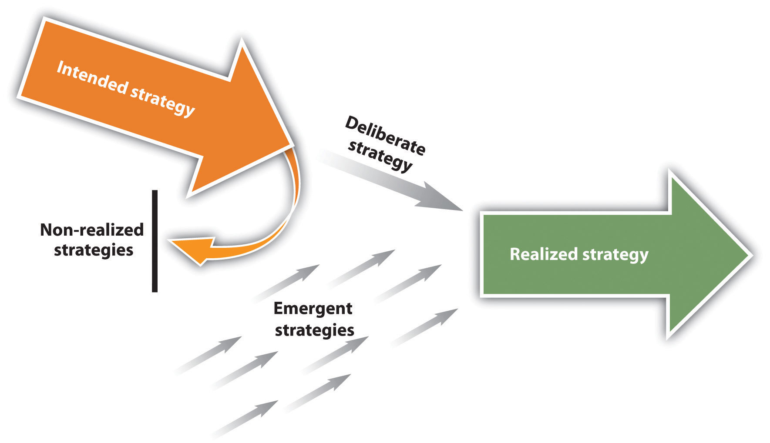
Henry Mintzberg's emergent strategy

Slide 24
Strategic drift
Strategic happens when organization strategy is no longer relevant to the external environment facing it
Environment forces
?????
Intended strategy through Deliberate planning process
Strategic drift

Slide 25
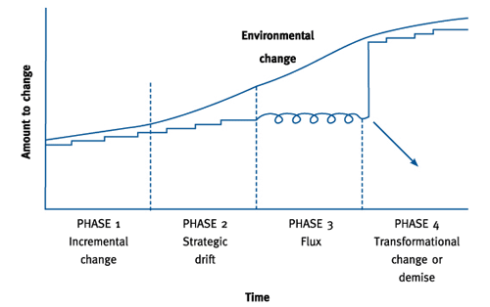
Rate of responding to the environmental change

Slide 26
What if you don’t redefine your business purpose –Strategic drift

Slide 27
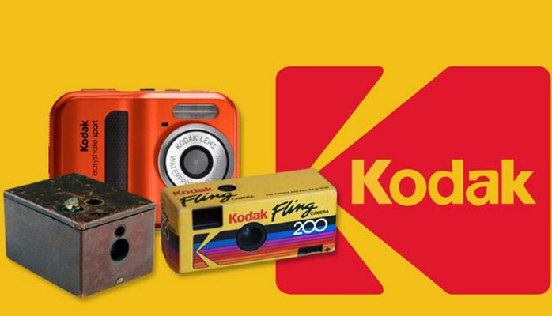
Slow response to the market led to strategic drift

Slide 28
How can companies survive a strategic drift
Organizational leadership and adaptable culture
Continues assessment of trends, emergence of direct and indirect competitors, technological changes and adjustment in to the current plan. https://www.youtube.com/watch?v=dqwAZKrc6vw

Slide 29
Financial Implication of strategic management decisions

Slide 30
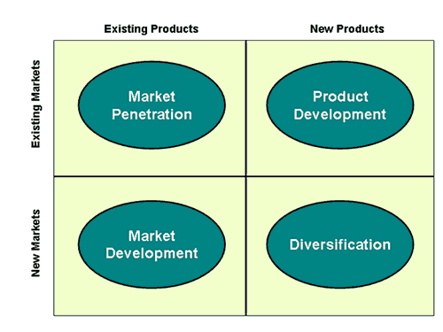
Corporate Strategic Decision
Growth decision
Source: Ansoff Matrix (Igo Ansoff)

Slide 31
Governance issue
Ownership
Control
Vs

Slide 32
Financial Feasibility
Evaluating the financial feasibility of such a decision will ensure that share holders money are invested in a profitable investment opportunity.

Slide 33
How to evaluate the corporate strategic decisions
Discounted Cash Flow Methods
Net Present Value (NPV)
Internal Rate of Return (IRR)
Non-Discounted Cash Flow Methods
Payback Method
Accounting Rate of Return

Slide 34
Projections
This is the most crucial part of the long term investment decision evaluation. Accurately forecast the cost and the revenue for given period will have significant impact to the decision.

Slide 35
Assume that your company management is planning to put up a 200 rooms hotel in Trincomalee which will require initial capital outlay USD 500 million. Project the possible cash flows for next five years and what factors should be considered in the determination of the cash flows.

Slide 36
Discounted Cash Flow Methods
NPV - the sum of discounted future cash flows less the initial cost
IRR - the discount rate where NPV = 0

Slide 37
Net Present Value (NPV)
NPV =
C1
(1 + r)¹
+
C2
(1 + r)²
+
C3
(1 + r)³
- C0
Initial Cost
Discounted cash flows
C1, C2, C3 = the project cash flows,
r = discount rate (related to risk of the project)
C0 = initial cost

Slide 38
Investment Decisions
The board of directors of Magoo plc. is considering investing in a new machine that is expected to have a three year life and will cost £80,000. The machine is used to produce a good that is expected to have the following cash flows over the three years of the machine’s life - Year 1 = £30,000; Year 2 = £50,000; Year 3 = £40,000. Cost of capital is 8%
Should it purchase the machine?

Slide 39
Fundamental Rule of Finance/Financial Economics
A capital investment decision is only worthwhile if it adds value. Thus, invest only in projects with a positive net present value

Slide 40
Student Activity
You are the financial manager advising the board of Alpha plc. on potential investment projects and have the choice between two projects of the same risk classification whose cash flows are given below:
Year | Cash flow of Project X | Cash flow of Project Y
0 | -120,000 | -80,000
1 | 20,000 | 40,000
2 | 60,000 | 40,000
3 | 100,000 | 30,000
Given that the firm expects to obtain a 10% return on projects of this level of risk, provide a recommendation to the board on the viability of the two projects

Slide 41
INTERNAL RATE OF RETURN (IRR)
Also based on Discounted Cash Flow, but calculates the discount rate that will give a Net Present Value of zero.
This also represents the return that the project is giving on the original investment, expressed in DCF terms.
The simplest way is to use trial and error - trying different rates until the correct rate is found. But this is laborious.
There is a formula, using linear interpolation.
Projects should be accepted if their IRR is greater than the cost of capital or hurdle rate.

Slide 42
IRR – Interpolation method
Where: L is the lowest discount rate
H is the higher discount rate
N_{L} is the NPV of the lower rate
N_{H} is the NPV of the higher rate

Slide 43
NPV and IRR
Gullane plc. are considering investing in a new machine that will cost £1 million. They estimate the machine will lead to an increase cash flow for the next three years of £500,000 in year 1, £600,000 in year 2, and £400,000 in year 3.
Given that Gullane plc. determine that the risk-adjusted cost of capital is 10%, calculate the Net Present Value of the machine and recommend whether to ahead with the investment or not
Calculate the Internal Rate of Return of the machine

Slide 44
Internal Rate of Return Decision Rules
If k > r reject. If the opportunity cost of capital (k) is greater than the internal rate of return (r) on a project then the investor is better served by not going ahead with the project and using the money to the best alternative use
If k < r accept. Here, the project under consideration produces the same or higher yield than investment elsewhere for a similar risk level

Slide 45
Payback
Consider Cash flows and NOT Profits
Evaluation based on period of recovery of the initial investment
ie. Number of years it takes to cover the cost of investment
Firms should look for early payback of capital invested
Decision criteria
Compare target payback with actual payback
If actual payback period < target payback - Accept project
If actual payback period > target payback - Reject project

Slide 46
Discount factor
Cost of capital of firm
Minimum rate of return, the firm must earn on its investments
Hence also the Required rate of return
Also considered as Opportunity cost
The required rate of return must cover, the cost of all long term sources of funds
Computed as the Weighted average cost of capital

Slide 47
Cost of capital (COC)
Cost of capital is the company cost of long term source of finance which is generally used to capitalized the asset.
There are tow major sources of long term funds.
Equity and Debt capital

Slide 48
Cost of Equity
The most commonly accepted method for calculating cost of equity comes from the Nobel Prize-winning capital asset pricing model (CAPM): The cost of equity is expressed formulaically below:
Re = r_{f} + (r_{m} – r_{f}) * β
Where: Re = the required rate of return on equity
r_{f} = the risk free rate
r_{m} – r_{f} = the market risk premium
β = beta coefficient = unsystematic risk

Slide 49
Cost of debt
Cost of debt is the interest paid to lenders
Debt is tax shield and should be adjusted to derive the cost of debt net of tax
Kd= I (1-Tax rate)

Slide 50
Weighted Average Cost Of Capital (WACC
Weighted average cost of capital (WACC) is a calculation of a firm's cost of capital in which each category of capital is proportionately weighted. All capital sources - common stock, preferred stock, bonds and any other long-term debt - are included in a WACC calculation.
All else equal, the WACC of a firm increases as the beta and rate of return on equity increases, as an increase in WACC notes a decrease in valuation and a higher risk.

Slide 51
WACC
Where,
WACC= KeVe + KdVd
Ve+Vd
Ke=Cost of equity
Ve=Value of equity
Vd=Value debt
Kd=Cost of debt

Slide 52
Student Activity
Ashanti plc., are considering an investment of USD 1.9 m to enter in to the north east region of Sri Lanka. The capital investment is expected to have equal lives of 3 years and the cash flows for each year is given below: Any capital expenditure project is evaluated at corporate WACC as a hurdle rate.
First year of the project is exempted from tax and 10% is applied after that.
 | Year 0 | Year 01 | Year 02 | Year 03
Investment | 1,900,000
Revenue |  | 1,000,000 | 1,400,000 | 2,000,000
Operational cost |  | 300,000 | 300,000 | 300,000
Ashanthi plc has 10 million equity and 5 million debt. It has 10% pa interest payment commitment in its debt and shareholders require 14 % return on their investment. The corporation tax rate is 28%.
You are required to evaluate the financial feasibility of the new expansion using NPV, IRR and the pay back period.

Slide 53
Strategic analysis
The basic frame work: Strategy as a link between the firm and its environment
The firm
Goals and values
Resources and capabilities
Structure and system
Micro and Macro environmental changes
Strategy
Strategic fit
Fundamental of strategy as the link between the firm and its external environment is the notion of strategic fit. For a strategy to be successful it must be consistent with the firm external environment and with its internal firm goals, resources and capabilities and the structure

Slide 54
Strategic analysis
Strategic analysis
Analysis of firm
Goals, values and performance , analyzing capabilities and resources
Analysis of macro , industry and competitive environment

Slide 55
Creating value
Successful strategy is creating value
Continuously creating customer value
Firm value
Shareholder value

Slide 56
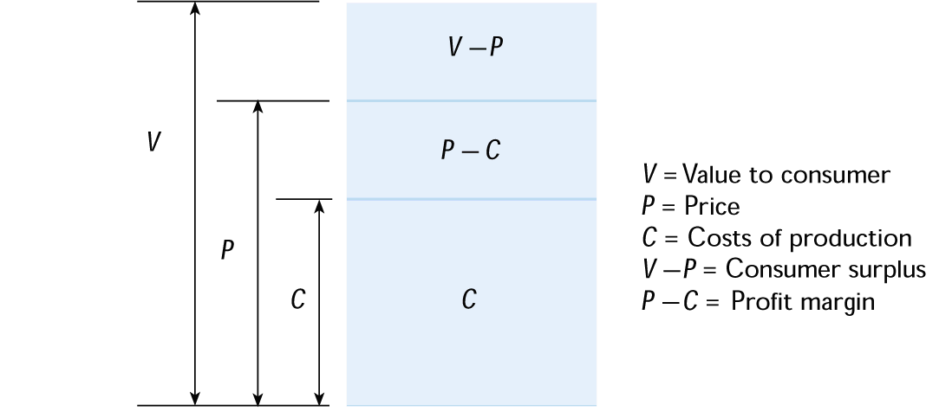
Value Creation

Slide 57
The Basic
Value Chain
Margin
Margin
Service
Technological Development
Marketing & Sales
Human Resource Mgmt.
Support Activities
Firm Infrastructure
Outbound Logistics
Procurement
Operations
Inbound Logistics
Primary Activities

Slide 58
Value Chains are part of a Total Value System
Supplier Value Chain
Firm Value Chain
Channel Value Chain
Buyer Value Chain
Notes:
69

Slide 59
In Whose interest ? Share holders Vs Stake holders
Shareholder capitalism
Stakeholder approach
Vs

Slide 60
Diagnosing the firm current strategy
Strategy formulation
Assess the current situation
Identify the current strategy of the firm and assess how well that strategy is doing in terms of financial performance
Identify the inadequacies of firm value drivers and reason for deviations-Internally driven or external driven
Strategic or operational level actions

Slide 61
Performance diagnosis
Diagnosis is primarily starts from accounting based financial performance indicator of Return on capital employed or ROCE. Any disaggregation of ROCE in to fundamental of value drivers. Du point analysis reflects the value drivers and its impact on ROCE.
ROCE
Return on sales
COGS/Sales
Depreciation/Sales
Sales on capital employed
Fixed asset turn over
SGA/Sales
Inventory turn over
Debtors turn over

